Slide 1
Guitars and String Vibrations
Using abstraction and math to create beautiful music

Slide 2
What we’re doing today
Introduction to string vibrations to understand how music is made
Using a digital guitar simulator to make music
Building cardboard and rubber band ukuleles to make music

Slide 3
Intro questions
How do string instruments work? Think about violins, guitars, cellos, ukuleles…
How do you tune different strings to different notes?
How do you use your fingers to make one string play many different notes?

Slide 4


Slide 5
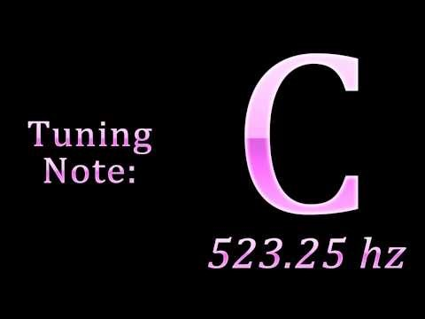
Notes and frequencies
The note that a string makes (a “C” or a “E-flat”) is represented mathematically as a frequency, measured in a unit called Hertz (Hz).
Hertz means the number of times the string vibrates every second.
For example, a C₅ note is 523.25Hz, Meaning a guitar string tuned to C₅ vibrates 523.25 times per second, like the tone heard here:

Slide 6
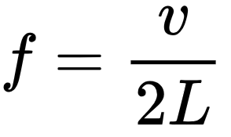
The frequency formula
Frequency can be calculated from the length of a string with the following inverse variation equation:
where f is the frequency, L is the length of the string (in meters), and v is called the “wave speed” of the string (in meters per second).
We’re going to use abstraction to treat v as constant for each string.

Slide 7
Quick practice with
If a string’s wave speed is 100m/s and it is 1m long, what frequency will it play when vibrating?
If a string’s wave speed is 80m/s and it is 30cm long, what frequency will it play when vibrating?
If a string is 60cm long and it plays a 200Hz note when vibrating, what is that string’s wave speed?
If a string’s wave speed is 70m/s and we want it to play a C₄ note (131.87Hz), how long does the string need to be?
Notes:
Answers: 50Hz, 133.33Hz, 240m/s, 26.54cm

Slide 8
Check for understanding of
As the length of a string gets longer, does the note it makes get higher or lower?
If we want to make the note a string plays higher, what do we do?

Slide 9
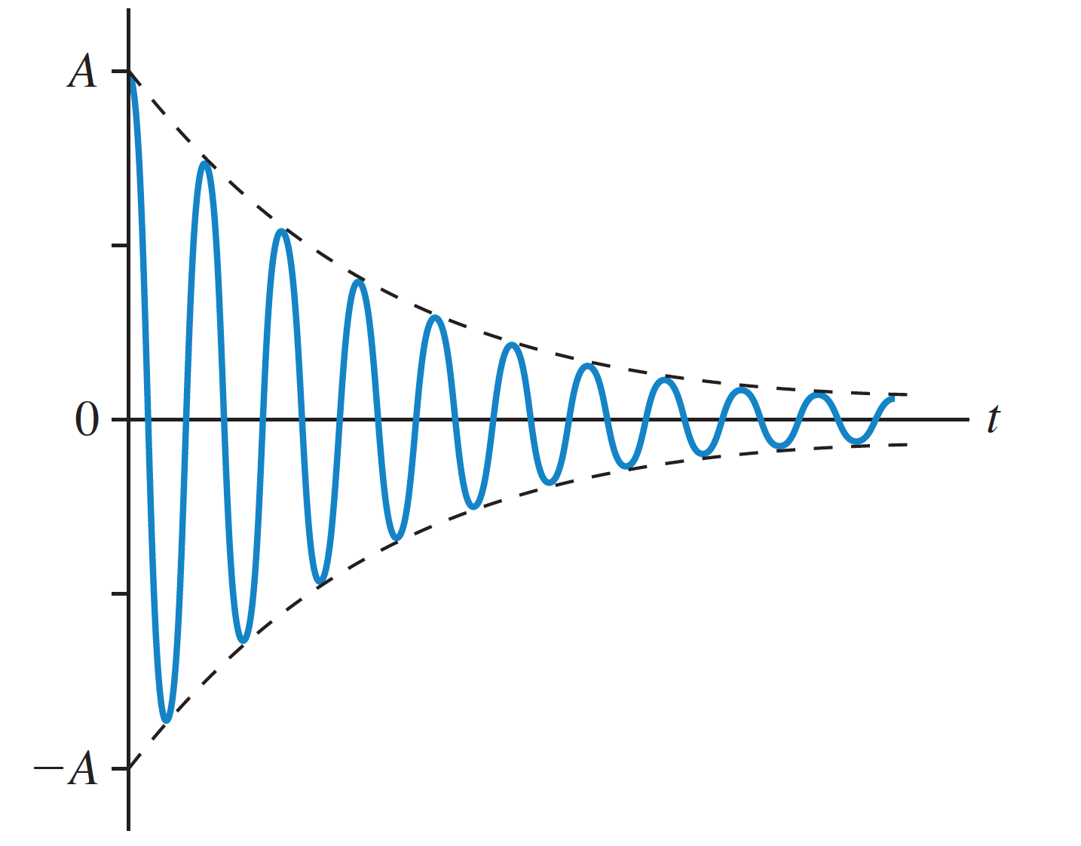
Why guitars sound like guitars
Without diving into too much physics, there are two things to know about guitars:
When you pluck a guitar string, you’re not hearing only the “fundamental” frequency you calculate, but also integer multiples of that frequency called “harmonics”. For instance, when playing a C₂ (65.4Hz), you’ll also hear some C₃ (130.8Hz), C₄ (261.6Hz) and C₅ (523.2Hz).
Guitar strings don’t stay at a constant volume forever - the vibrations decay exponentially. Different guitars decay slightly differently, leading to different sounds.

Slide 10
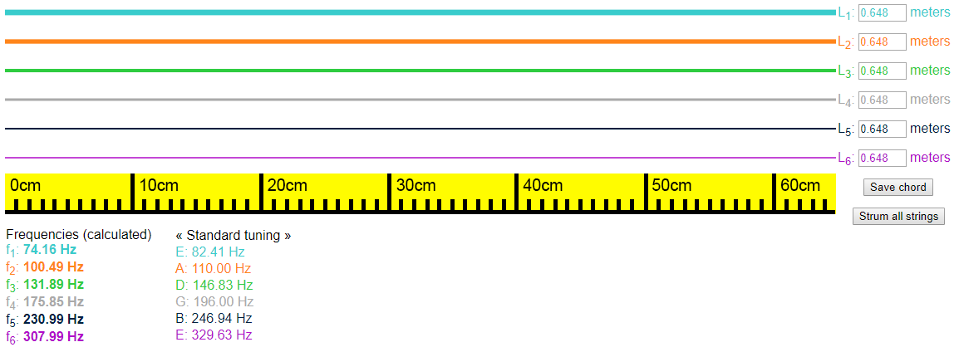
Digital guitar simulator
tinyurl.com/ctstrings

Slide 11
Digital guitar simulator
Change the length of each string by editing these numbers
Click on a string to pluck it!
Frequencies for each string are recalculated as you edit lengths
Find frequencies for standard tuning and common chords
Save all six string lengths as a chord and strum away!

Slide 12
Calculating wave speeds with
We need to calculate the wave speed for each string using a known length and frequency. Here’s the first string as an example:
v₁ = f₁ ✕ 2 L₁ = 74.16 ✕ 2 ✕ .648 = 96.11 m/s
Now, calculate the wave speed for the remaining five strings.

Slide 13
Calculating string lengths with
Once we have calculated the wave speed for each string, we can tune them to any chords we’d like! You will pick two chords to tune your guitar to, given the frequencies shown underneath the strings.
For example, for “standard tuning”, f₁=82.41Hz
L₁ = v₁ / (2 f₁) = 96.11 / (2 ✕ 82.41) = .583m

Slide 14

Imagine by John Lennon
Choose two of the following chords and calculate the string lengths for those as well. Make sure to save them in the simulation!
Am C Dm E F G
Once everyone has calculated string lengths for and saved these chords, we will play along to Imagine as a class. If you finish, calculate more chords to play more!

Slide 15


Slide 16
Let’s build!
Wrap one 12” rubber band, one 14” rubber band and one 17” rubber band around your box.
Insert two wooden dowels between the rubber bands and the closed, “bottom” part of your box. How do the different rubber bands sound?
Experiment with moving the dowels closer together and further apart. What happens to the notes of each rubber band as you move the dowels?

Slide 17
Marking notes
Place one of your dowels at one end of the box, and do not move it again. Using the reference notes in the digital guitar simulation to tune, mark the position of the second dowel to achieve different notes on each rubber band.
This will help you play along with music - think of these markings like frets on a guitar!

Slide 18
Some simple melodies to try
Star Wars:
G_{low} D C B A G_{high} D C B A G_{high} D C B C A
Super Mario:
E E E C E G_{high} G_{low}
Twinkle Twinkle Little Star:
C C G G A A G F F E E D D C G G F F E E D G G F F E E D C C G G A A G F F E E D D C
Jingle Bells:
E E E E E E E G C D E F F F F F E E E E E D D E D G
Ode to Joy:
E E F G G F E D C C D E E D D E E F G G F E D C C D E D C C D D E C D E F E C D E F E D C D G_{low}

